Slide 1

WAREHOUSE ACCOUNTING CRM
Borcelle University

Slide 2




TOPIC
The goal of the project is to create a lightweight CRM system for a warehouse
The main consumer is a small business or individual cells of network marketing.

Slide 3

WHAT WAS DONE
Everything: idea, structure, implementation
Implementation, tests, connection of additional applications
This presentation

Slide 4
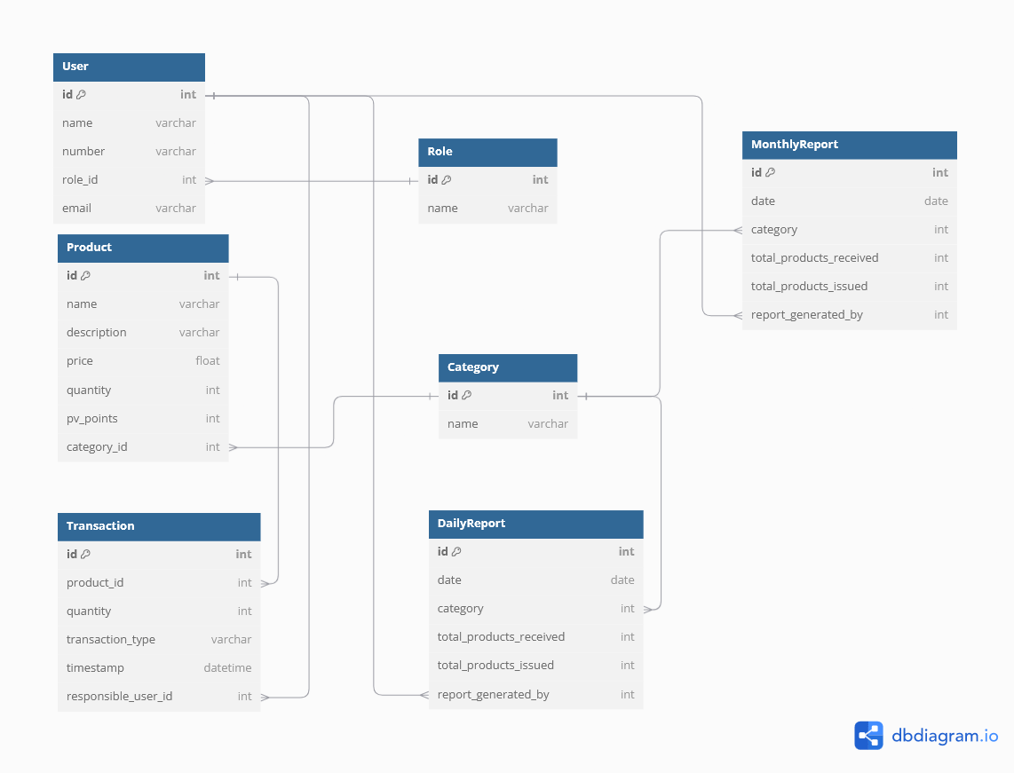
STRUCTURE OF THE SYSTEM

Slide 5
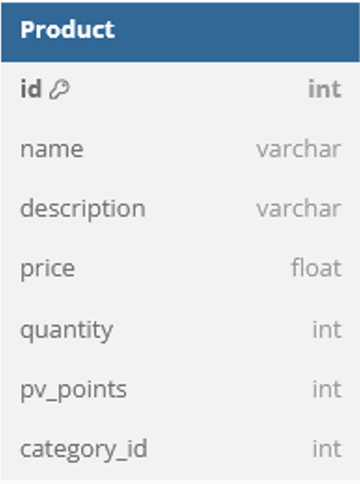
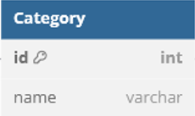
PRODUCTS
CategoryViewSet
Purpose: Handles CRUD operations for the Category model.
Methods:
list(): Retrieves and displays a list of all categories.
create(): Creates a new category, logging the user responsible.
Permissions: Only accessible by admin users (IsAdminUser).
ProductViewSet
Purpose: Handles CRUD operations for the Product model.
Methods:
list(): Retrieves and displays a list of all products.
create(): Creates a new product, logging the user responsible.
Permissions: Only accessible by admin users (IsAdminUser).
product_list (Function-based view)
Purpose: Retrieves and displays a list of all products using a function-based view.
Logging: Logs the user accessing the product list.
Category is part of product

Slide 6
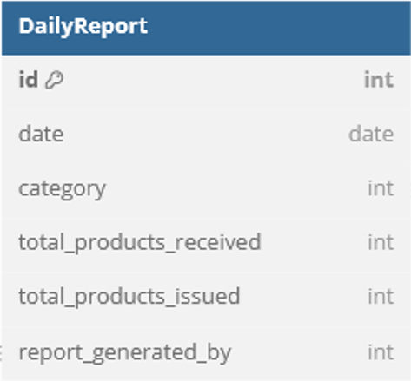
DAILY REPORT
DailyReportViewSet
Purpose: Manages CRUD operations for DailyReport objects.
Caching: Caches report data for 10 minutes (timeout=600), using a cache key based on the report's ID.
Logging: Logs the actions performed (create, update, retrieve, delete).
Methods:
perform_create: Creates a new daily report and caches it.
retrieve: Retrieves a single daily report. First checks the cache, then the database if not found in cache.
update: Updates a daily report and refreshes the cache.
destroy: Deletes a daily report and removes it from the cache.
daily_report_list (Function-based View)
Purpose: Displays a list of all daily reports.
Caching: Caches the entire list of daily reports for 10 minutes (timeout=600).
Logging: Logs when the report list is accessed.

Slide 7
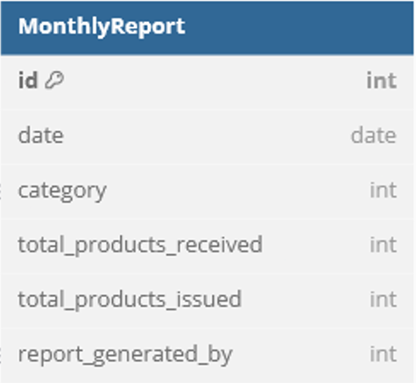
MONTHLY REPORT
MonthlyReportViewSet
Purpose: Manages CRUD operations for MonthlyReport objects.
Caching: Caches report data for 10 minutes (timeout=600), using a cache key based on the report's ID.
Logging: Logs the actions performed (create, update, retrieve, delete).
Methods:
perform_create: Creates a new monthly report and caches it.
retrieve: Retrieves a single monthly report. First checks the cache, then the database if not found in cache.
update: Updates a monthly report and refreshes the cache.
destroy: Deletes a monthly report and removes it from the cache.
monthly_report_list (Function-based View)
Purpose: Displays a list of all monthly reports.
Caching: Caches the entire list of monthly reports for 10 minutes (timeout=600).
Logging: Logs when the report list is accessed.

Slide 8
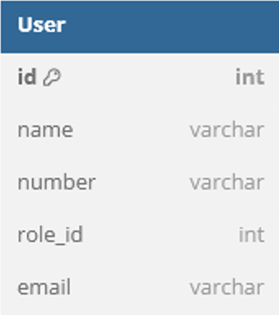
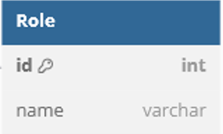
USERS
RegisterPageView (Class-based View)
Purpose: Handles the registration page display for users.
Logging: Logs when the registration page is accessed.
Template: Renders the register.html template.
Method:
get: Logs the access of the registration page and renders the register.html template for the user.
Role is part of user. There no functions

Slide 9
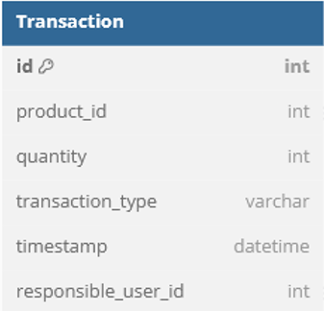
TRANSACTION
TransactionViewSet (Class-based View)
Purpose: Handles CRUD operations for the Transaction model via the Django Rest Framework’s ModelViewSet.
Logging: Logs when the transaction list is accessed and when a new transaction is created.
Methods:
list(): Logs when the list of transactions is accessed by a user and then retrieves the list using the ModelViewSet’s list method.
create(): Logs when a new transaction is created by a user and then creates the transaction using the ModelViewSet’s create method.
transactions_list (Function-based View)
Purpose: Displays the list of transactions in the application.
Logging: Logs when the transactions list is accessed by a user.
Template Rendering: Renders the transactions_list.html template with the list of transactions.

Slide 10
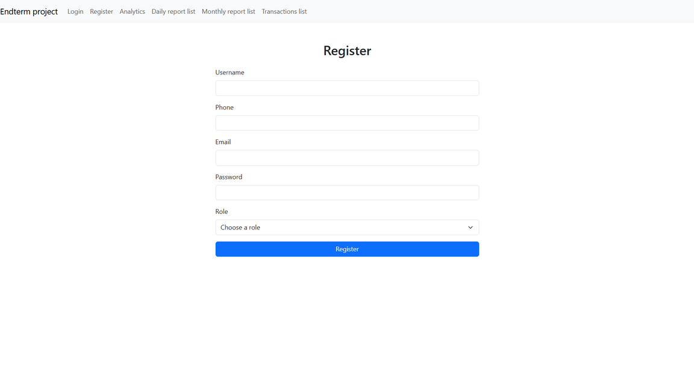
TEMPLATES
RegisterPageView → register.html
Description: The RegisterPageView view handles rendering the user registration page.
Template: The view uses the render() method to render the register.html template.
Action: When a user navigates to the registration page, Django uses the RegisterPageView view to render the register.html template. This template displays the registration form where the user can input their details.
Relationship:
View: RegisterPageView
Template: register.html

Slide 11
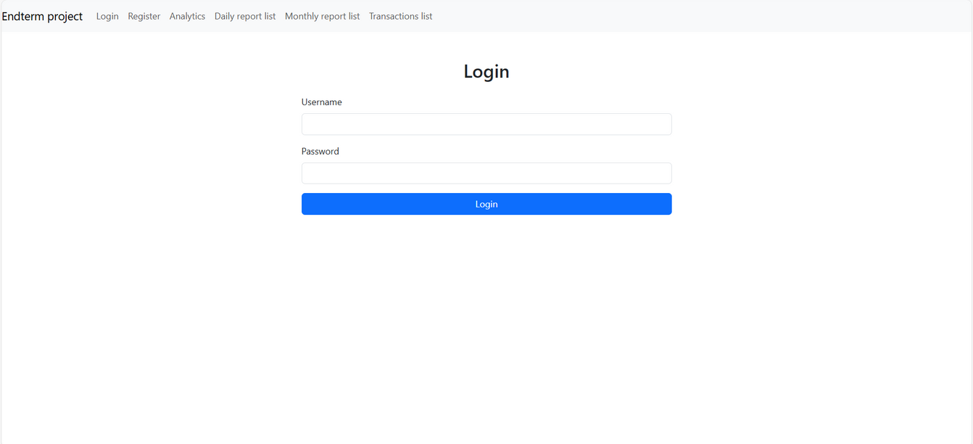
TEMPLATES
LoginPageView → login.html
Description: The LoginPageView view is responsible for rendering the login page.
Template: The login.html template is rendered through the render() method in the LoginPageView.
Action: When the user visits the login page, the LoginPageView view renders the login.html template, providing a form for users to enter their username and password.
Relationship:
View: LoginPageView
Template: login.html

Slide 12
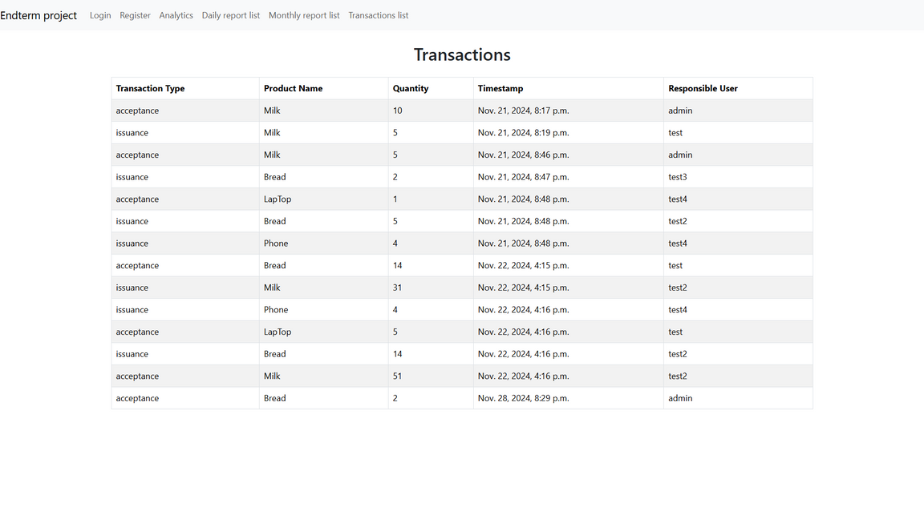
TEMPLATES
TransactionViewSet → Template for Transactions
Description: The TransactionViewSet view handles API requests for creating and listing transactions.
Template: The transactions_list.html template is used to display the transaction list on a webpage.
Action: When the user requests the transaction list page, the transactions_list view fetches all transactions from the database and renders the transactions_list.html template, which displays the transactions in a table format.
Relationship:
View: transactions_list
Template: transactions_list.html

Slide 13
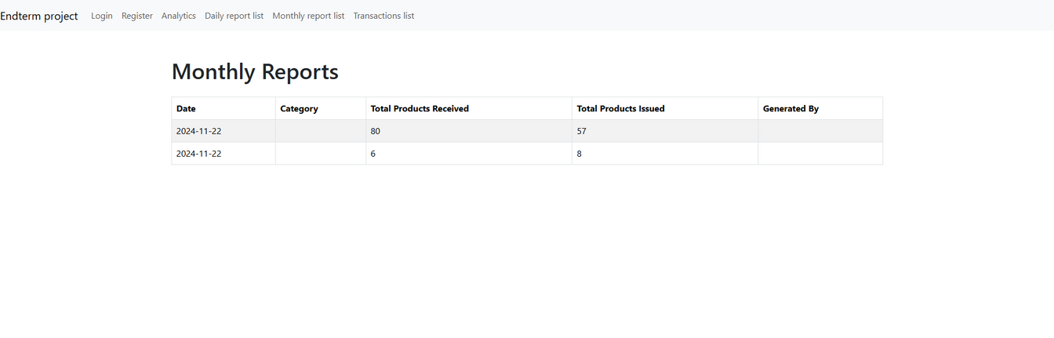
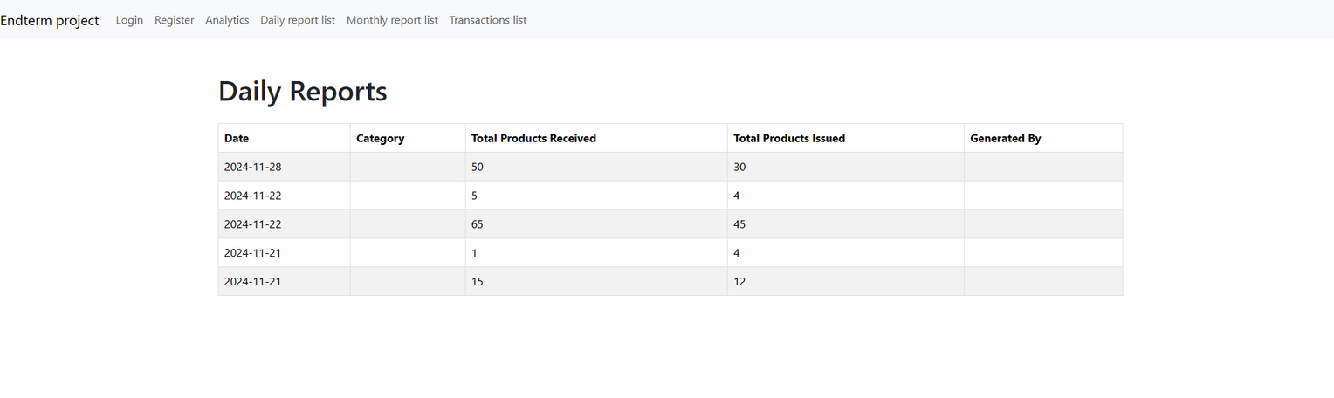
TEMPLATES
DailyReportViewSet / MonthlyReportViewSet → Report Templates
Description: The DailyReportViewSet and MonthlyReportViewSet views handle requests for daily and monthly report lists.
Template: The daily_report_list.html and monthly_report_list.html templates are used to render daily and monthly reports, respectively.
Action: When the user requests the report lists, the views query the database, retrieve the reports, and pass the data to the templates. These templates then display the reports in table format with detailed information.
Relationship:
View: daily_report_list → Template: daily_report_list.html
View: monthly_report_list → Template: monthly_report_list.html

Slide 14
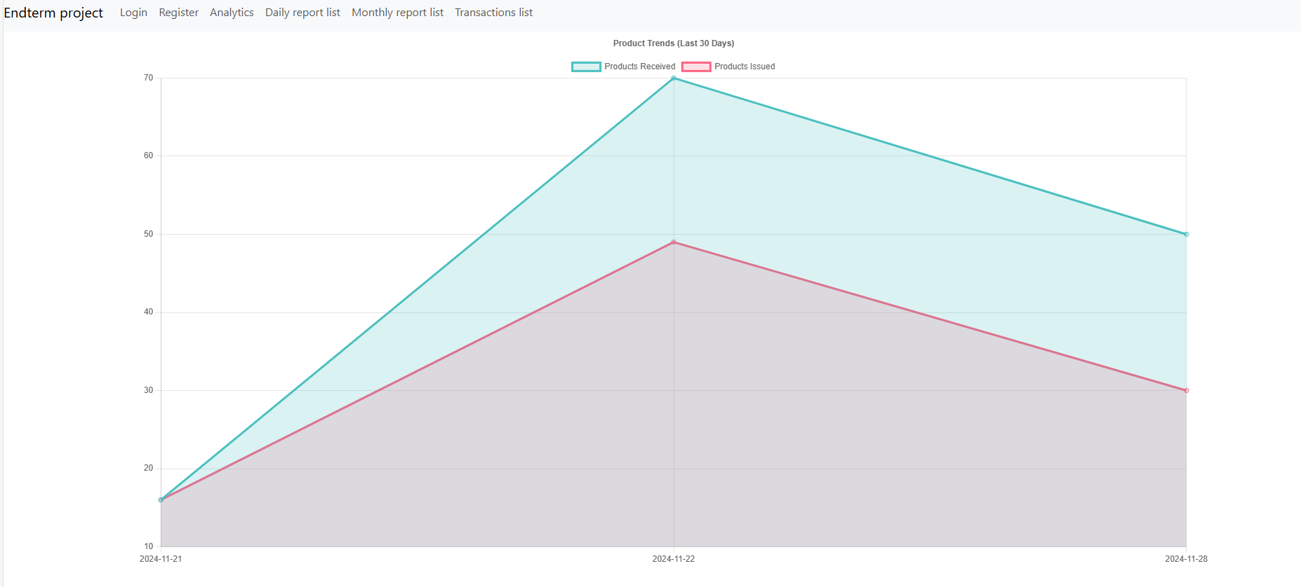
TEMPLATES

